Slide 1

OGC API – Tiles Sprint
Sponsored by
Day 2
24th April 2020

Slide 2
Reminders
Objectives
Develop implementations of OGC API – Tiles
Test implementations of OGC API – Tiles (including those from VTP2)
Provide feedback on the specification
Housekeeping
Keep your camera off at all times.
Only switch your microphone on when speaking.
Follow the chair/facilitator’s guidance.
Say your name before speaking...
“Hi, this is Gobe…”

Slide 3
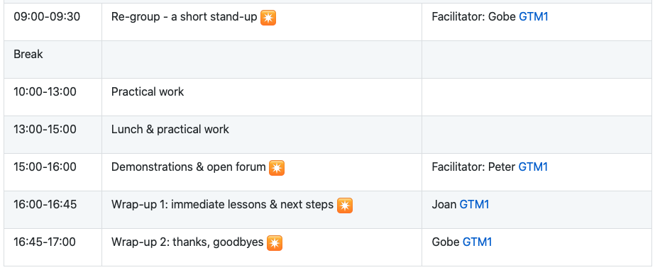
Schedule – Day 2

Slide 4
Sprint Cycle
Discuss in Telecon
Implement
Discuss on Gitter
Show & Tell

Slide 5

Logistics
Gotomeeting
You are here!
Gitter
https://gitter.im/opengeospatial/OGC-OS-Sprint-04-2020
GitHub
Public repo https://github.com/opengeospatial/OGC-OS-Sprint-04-2020
OGC API – Tiles issues https://github.com/opengeospatial/OGC-API-Tiles/issues
Other Sprint issues https://github.com/opengeospatial/OGC-OS-Sprint-04-2020/issues

